Slide 1

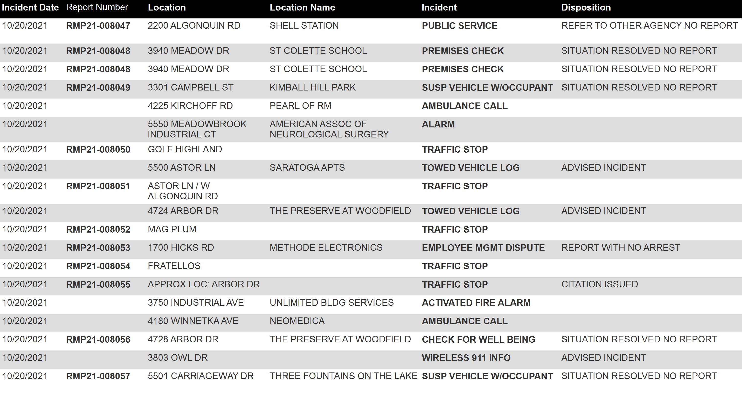
ROLLING MEADOWS POLICE DEPARTMENT
DAILY BLOTTER
10/21/2021 7:19:05 AM

Slide 2
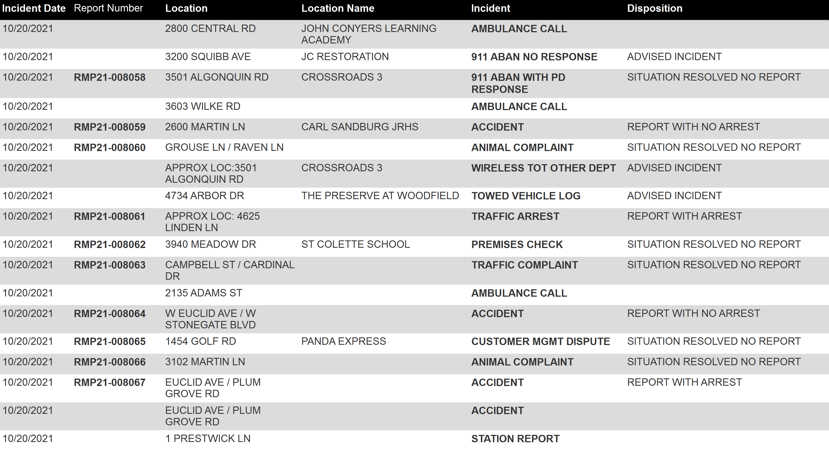
ROLLING MEADOWS POLICE DEPARTMENT
DAILY BLOTTER
10/21/2021 7:19:05 AM

Slide 3
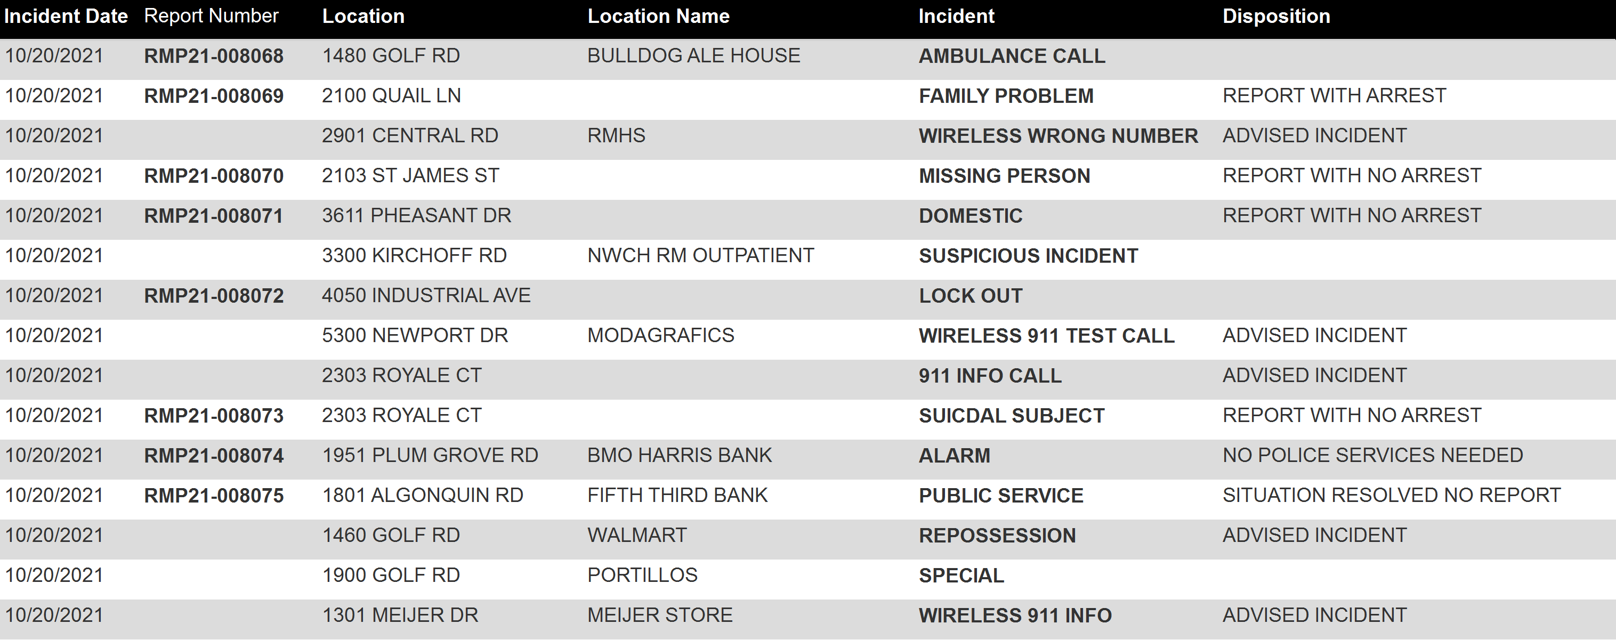
ROLLING MEADOWS POLICE DEPARTMENT
DAILY BLOTTER
10/21/2021 7:19:05 AM

Slide 4
ROLLING MEADOWS POLICE DEPARTMENT
DAILY BLOTTER
10/21/2021 7:19:05 AM

